Slide 1

TODAY'S RESOURCE FOR A BRIGHTER TOMORROW, SOLAR POWER:A WORLDWIDE RESOURCE, GENERATE TODAY, ENJOY TOMORROW. ELECTRICITY THE LOCK, COSMICVOLT THE KEY, SOLAR PANELS THE KEY GROOVES

Slide 2
TODAY'S RESOURCE FOR A BRIGHTER TOMORROW, SOLAR POWER:A WORLDWIDE RESOURCE, GENERATE TODAY, ENJOY TOMORROW. ELECTRICITY THE LOCK, COSMICVOLT THE KEY, SOLAR PANELS THE KEY GROOVES

Slide 3
Why should I go for solar based captive power? What are the key advantages of using solar PV as a replacement for diesel? How much solar PV capacity do I need for my electricity requirements? How much will it cost to install a solar PV captive system? What are the operational and maintenance costs for a solar PV power system for my premises? What are the key things I should look out for before installing a solar PV system? How much space will I need for the captive PV installation? Should I use solar as a backup power or as a mainstream power source? Will I be able to depend completely on solar energy for my day time operations? If I operate night shifts, will I need a storage system (battery) for my energy needs? Can I sell my excess energy to the grid? What are the components of the solar PV system? What is the lifetime of the system and its components? Am I eligible for availing government incentives?
Few questions arise in your mind like

Slide 4
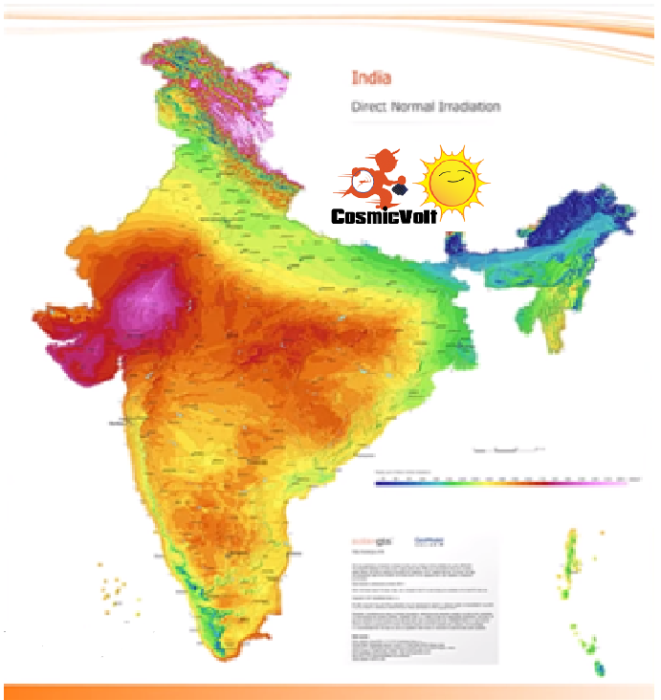
www.cosmicvolt.com Email-Id: cosmicvolt.com@gmail.com Office Mobile:9448649530
Solar Map of India

Slide 5
This is everything you need. 1. Efficiency begins at Home/Office/Industry. Investing in Solar Power is better than putting your money in the Bank 2. Solar power for your Apartment building? Energy bills are burning a hole into community savings. So how can you overcome this? 3. Figure out what you might Need. IMPACT, Technology: Panels and Inverters. What are best things to consider while choosing Solar panels, Maintenance, Economics?, Why the Corpus?, What’s OPEX?, Who’s gone Solar? How are they doing?, Why is it gaining traction now? How easy is it to Go Solar? 4. Choosing your Installer. 5. Know the Difference you can make. 6. Make a Decision. Contact Cosmicvolt for getting yourself GoGreen
Looking to power your home or Office or Industry with Renewable solar energy?

Slide 6
Understanding more about Solar Energy & Its components Open cosmic volt Explanation during Google Meet 1 What is a Solar PV System and how does it work? 2 What are the different types of Solar Rooftop PV Systems available?. 3 Why Should I go Solar? 4 Business Model? Do we install in RESCO Model for residential projects? 5 What is the warranty of the product? 6 Is my Rooftop right for the Solar Plant? 7 What are the approvals needed to install a Solar System at home? 8 How much area is required to install a Rooftop Solar system? 9 How do different weather conditions impact a Solar System’s output? 10 What is the maintenance required for a Solar System? 11 What is net metering? 12 What is the Return on Investment and Savings? 13 How does solar plant impact my roof integrity? 14 How much energy will be generated from a 1 KW solar plant? 15 Will a Solar Plant meet 100% of my power requirement? 16 Will my plant generate during the night?

Slide 7
About Cosmicvolt Our Strength Scope of Work Warranty Project Management & Quality Assurance Safety Plan Beneficiary Whom to contact for O&M Questions to be sent to cosmicvolt.com@gmail.com

Slide 8
About Cosmicvolt Our Strength Scope of Work Warranty Project Management & Quality Assurance Safety Plan Beneficiary Whom to contact for O&M Questions to be sent to cosmicvolt.com@gmail.com

Slide 9
About Cosmicvolt Our Strength Scope of Work Warranty Project Management & Quality Assurance Safety Plan Beneficiary Whom to contact for O&M Questions to be sent to cosmicvolt.com@gmail.com

Slide 10
About Cosmicvolt Our Strength Scope of Work Warranty Project Management & Quality Assurance Safety Plan Beneficiary Whom to contact for O&M Questions to be sent to cosmicvolt.com@gmail.com

Slide 11
About Cosmicvolt Our Strength Scope of Work Warranty Project Management & Quality Assurance Safety Plan Beneficiary Whom to contact for O&M Questions to be sent to cosmicvolt.com@gmail.com

